Slide 1


Visvesvaraya Technological University
Jnana Sangam, Belagavi
IMPLEMENTATION OF FACEBOOK FAKE PROFILE DETECTION TOOL.
Presented By
Rishika Yadannavar
Swati Bhajantri
Yashodha Gokak
Apoorva Savadi
Guide Name
Dr. Dinesha H. A

Slide 2
SLIDE CONTENTS
What is facebook ?
Problem statement
Introduction
Literature survey
Objectives and goals
Requirements
External interface and non functional requirements
Improvements
Methodology
System Design
Support vectore machine
Research methodology
Experimental of csv
Implementation
Test cases
Result and analysis
Conclusion and future scope

Slide 3
WHAT IS FACEBOOK?
Facebook is one of the fastest growing social networks worldwide. This is a website where every user can make registration and create account for free.
By creating Facebook profile, the user can fill different information about himself and share content (text, pictures, music, video etc.) with others.

Slide 4
INTRODUCTION
Social networks such as Facebook, Twitter and Google+ have attracted millions of users in the last years.
The potential of social networks is often misused by malicious users who extract sensitive private information of unaware users.
One of the most common ways of performing a large-scale data harvesting attack is the use of fake profiles, where malicious users present themselves in profiles impersonating fictitious or real persons.
The main goal of this research is to evaluate the implications of fake user profiles on Facebook. To do so, we established a Machine learning algorithms with python, the social engineering experiment, and analyzed the interactions between fake profiles and regular users to eventually undermine the Facebook business model.
As a result of our work, we provided a set of countermeasures to increase the awareness of users.

Slide 5
Literature Survey
Sr. No. | Paper Name | Author | Year of Publication | Methodology Used | Description | Advantage
1. | A Hybrid scheme for detecting fake accounts in Facebook. | M. Smruthi, N.Harini | 2019 | KNN algorithm, Support vector, Naïve Bayes algorithm | Using Algorithms to the model casual relations among people in social networks. | All the five supervised were applied to the mixed datasets of fake accounts and real accounts.
2. | Prediction of fake profiles on Facebook using supervised machine learning techniques. | Suheel Yousuf Wani, Mudasir M. Kirmani, Syed Imamul Ansarulla | 2016 | Support vector machine, decision tree, Artificial neural networks and Naïve Bayes. | The proposed model as applied sophisticated noise removal and data normalization techniques | A combination of two or more machine learning algorithms can be used for detection of fake as well as genuine profiles on Facebook.
3. | Detection of Fake Profiles in Social Media | Aleksei Romanov, Alexander Semenov, Oleksiy Mazhelis and Jari Veijalainen | 2017 | features to train neural networks, SVMs, Naïve Bayes. | Manually labelled 3000x2 Facebook profiles as human, bots or cyborgs. | Results reveal that personal attributes can be inferred with high accuracy especially when people are connected with strong relationships.
4. | Detecting Malicious Facebook Applications | Sazzadur Rahman, Ting-Kai Huang, Harsha V. Madhyastha, and Michalis Faloutsos | 2015 | focused by leading or upcoming researchers while emphasizing the security | a huge amount of scope and gap that has to be filled with efficient and effective strategies. | Marketing benefits Education creativity
5. | Understanding the behavior of malicious applications in social network | A. Makridakis et al. | 2010 | antisocial networks, that refers to distributed systems based on social networking web sites | article we show that social networking web sites have the ideal properties to become attack platforms. | An adversary can take control of a visitor's session by remotely manipulating their browsers through legitimate web control
6. | Security Issues in Online Social Network | H. Gao, J. Hu, T. Huang, J. Wang and Y. Chen | 2011 | threats to OSN as well countermeasures to some of these threats. | Online Social network cyber security profile cloning botnet | new techniques to avoid and prevent such attacks.
7. | Towards detecting fake user accounts in facebook | A. Gupta and R. Kaushal | 2017 | The materials and fin design as a two-major factor to increase the heat dissipation | Cyber security protects the system from unauthorized access and destruction of data | Ransomware, Cybersecurity, Malware, Machine Learning
8. | Safe sonet: a framework for building trustworthy relationships. | MR, Neethu.; HARINI, N. | 2018 | SVMs, Naïve Bayes. | Being unaware of their audience people on social networks inconsiderately share many personal items. | algorithms can be used for detection of fake as well as genuine profiles on Facebook.

Slide 6
Objectives and Goals
In today’s online social networks there have been a lot of problems like fake proﬁles, online impersonation, etc. Till date, no one has come up with a feasible solution to these problems.
In this project we intend to give a framework with which the automatic detection of fake proﬁles can be done so that the social life of people become secured and by using this automatic detection technique we can make it easier for the sites to manage the huge number of proﬁles, which can’t be done manually.
Our goal is to provide a secure communication channel to the users.

Slide 7
REQUIREMENTS
SOFTWARE REQUIREMENTS
Operating system : Windows 7 and above.
Coding Language : Python,
IDE : Sublimetext3 Pycharm
HARDWARE REQUIREMENTS
System : Intel I3 Processor and above.
Hard Disk : 200 GB.
Monitor : 15 VGA Color.
Ram : 4 GB.

Slide 8
EXTERNAL INTERFACE AND NON FUNCTIONAL REQUIREMENTS
EXTERNAL INTERFACE REQUIREMENTS:
User Interfaces
Hardware Interfaces
Software Interfaces
Communication Interfaces
NON FUNCTIONAL REQUIREMENTS:
Performance Requirements
Safety Requirements
Security Requirements
Software Quality Assurance

Slide 9
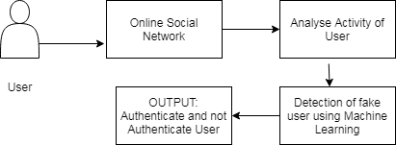
SYSTEM DESIGN
Fig:1

Slide 10
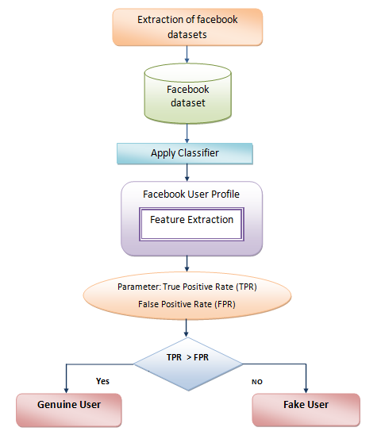
METHODOLOGY
Fig: workflow

Slide 11

SUPPORT VECTOR MACHINE
SVM is supervised machine learning techniques used for classification.
It finds the hyper plane to classify the data.
SVM are able to accept a large amount of random data and suitable to detect the fake accounts 2 on social networking sites based on various characteristics of accounts
SVM are machine learning techniques which efficiently work on different kind of data sets.
The execution time of SVM is less because it takes less time to train the SVM
Fig: SVM

Slide 12
RESEARCH METHODOLY
Steps for how SVM is used to classify:
Data collection
Filtration of dataset
Clustering of dataset
Feature selection
Classification of dataset

Slide 13
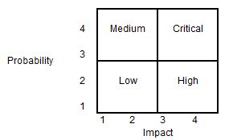
RESULT AND ANALYSIS
Risk Identification
Any unauthorized user should be prevented from accessing the system. Password authentication can be introduced. To ensure the safety of the system, perform regular monitoring of the system so as to trace the proper working of the system. An internal staff has to be trained to ensure the safety of the system. He has to be trained to handle extreme error cases.
Risk Analysis
Risks can be evaluated based on quantity. Project managers need to analyze the likely chances of a risk occurring with the help of a matrix.
As mentioned above, risks contain two sides. It can be either viewed as a negative element or a positive element. Negative risks can be detrimental factors that can haphazard situations for a project.
Therefore, these should be curbed once identified. On the other hand, positive risks can bring about acknowledgements from both the customer and the management. All the risks need to be addressed by the project manager.
Fig: Risk Analysis

Slide 14
Conclusion and future scope
Fake accounts are being continuously evolving in online social media.
Therefore, it is very essential to invent new methods to detect Fake profiles in online social media.
For the detection of Fake accounts the user timeline information namely status-count, followers-count, etc. were used.
Desired use of data and individual privacy presents an opportunity for privacy-preserving social network data mining. That is, the discovery of information and relationships from social network data without violating privacy.
We address two issues in this paper: (a) how exactly third party users launch an inference attack to predict sensitive information of users, and (b) are there effective strategies to protect against such an attack to achieve a desired privacy utility tradeoff.
We propose a Collective Method that takes advantages of various data manipulating methods to guarantee sanitizing user data does not incur a bad impact on data utility. Using Collective Method, we are able to effectively sanitize social network data prior to release.

Slide 15
THANK YOU

